Slide 1


Digital Electronics Fundamentals 201.2
Labs:
-Setting up with 5V
-Simple NAND Circuit
-Latching NAND Circuit

Slide 2
1 Setting Up for 5V
Logic Gates are very finicky about their voltages. Therefore, 5V logic gates require exactly 5V (regulated) from the power supply.
You should not lean unconnected inputs (floating) for your logic gates. In logic terms, a floating input is undefined.

Slide 3
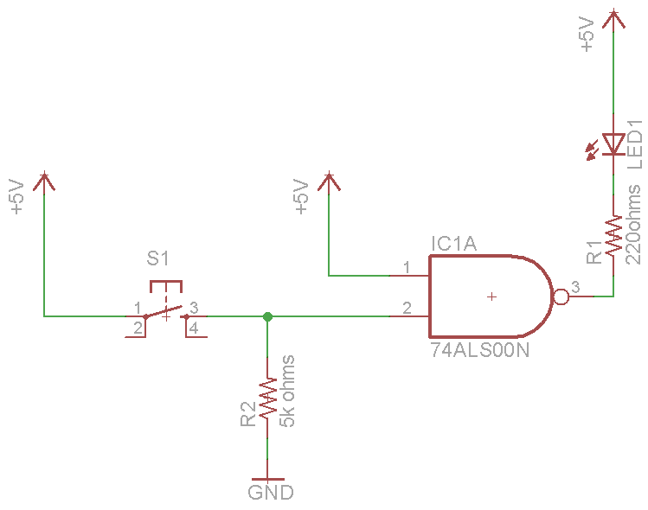
2 Lab: Simple NAND Circuit
When both inputs are HIGH, what will the LED be ON or OFF?

Slide 4
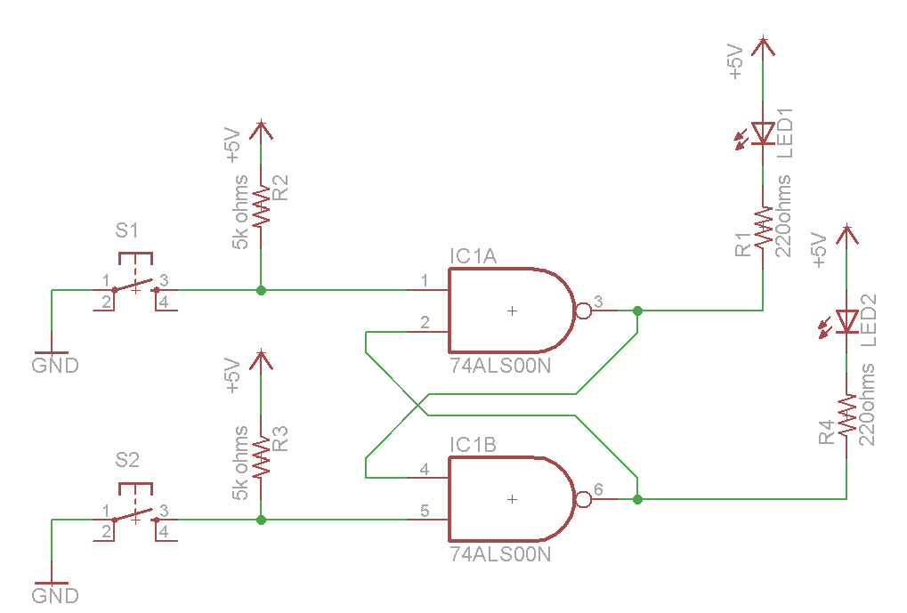
3 Lab: Latching NAND Circuit
Create a truth table for this device.

